Slide 1


Long-Term Effects of Conbination therapy in Patients with Alzheimer’s Disease
Oscar L. Lopez, M.D.
Departments of Neurology and Psychiatry
University of Pittsburgh School of Medicine

Slide 2
Epidemiology
Alzheimer’s disease causes 60-85% of dementia in people age >65
5-10% of the subjects age >65 have AD.
45% of the subjects age >85 may have AD
The World Alzheimer Report estimates that there are 35.6 million people living with dementia worldwide (4-5 millions in the U.S).
There will be 65.7 millions by 2030 and 115.4 by 2050
(approx. 9 -11 millions in the U.S.).
Lopez, 2012

Slide 3
Prevalence of dementia in the
Cardiovascular Health Study (CHS)
Percent
Fitzpatrick et al, JAGS 2004; 52: 195-204

Slide 4
Risk Factors for
Alzheimer’s Disease
Probable
Age
APOE-4 allele
Possible
Women
History of head trauma
“Protection”
Moderate alcohol intake
Cognitive activity
Cerebrovascular disease
Family history of dementia
Mediterranean diet
Physical activity
Family history of Down’s syndrome
Lopez, 2011

Slide 5
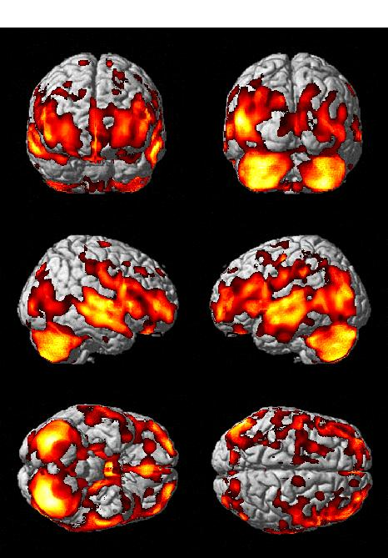
The Aging Brain
Raji et al., Neurology, 2010
Surface Rendered Statistical Parametric Maps show specific voxels that indicate
a negative correlation between age and grey matter volume loss in 212 subjects
(167 cognitively normal subjects that remained normal 4-5 years after the scan and 45 Probable AD patients).
Raji, et al. Neurology 2009
Notes:
Figure 1: Age related brain atrophy projected onto the Standard Single Subject MNI template.

Slide 6
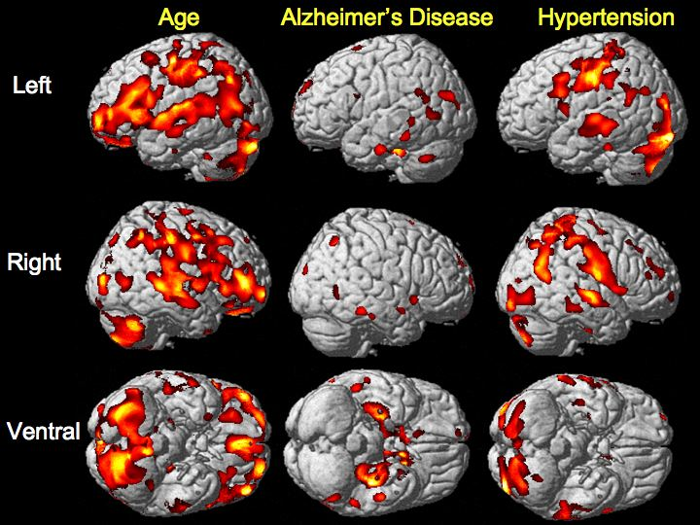
Brain volume in aging, Alzheimer’s disease, and in
cognitively normal subjects with hypertension
Raji et al. Neurobiology of Aging, 2012

Slide 7
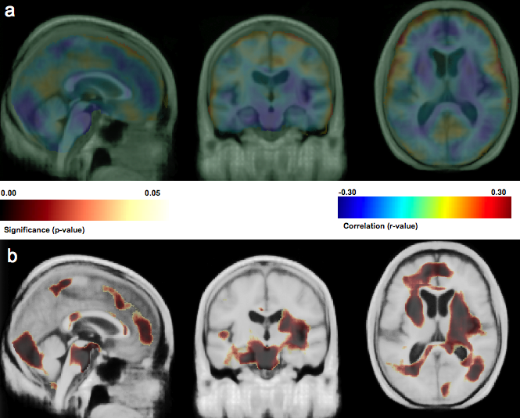
Brain volume and diabetes mellitus in cognitively normal elderly individuals
Significance map: splenium (black arrow) and genu of the corpus
callosum (green arrow), and frontal lobes (red arrow). Raji et al., Human Brain Mapping 2010
Notes:
Figure 3

Slide 8
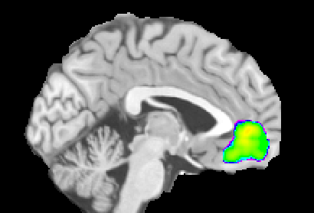
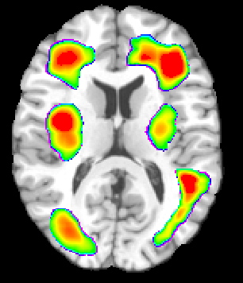
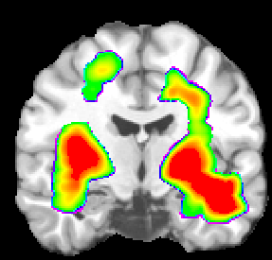
BMI and cerebral volume
a
Higher BMI was associated with lower
GM and WM volumes in orbital frontal cortex
(part a, blue box), anterior cingulate gyrus
(part a, blue box), medial temporal lobe
(part b, black arrows), and subcortical
WM (part c, black asterisk).
c
C
b
*
*
Raji et al., Human Brain Mapping 2010
Notes:
Figure 4

Slide 9
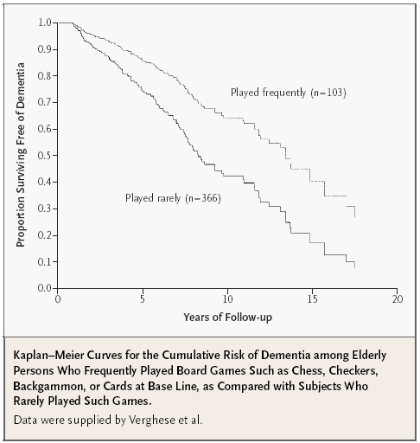
Leisure (Cognitive) Activities and the Risk of Dementia
Verghese, et al. NEJM 2003; 348:2508-16

Slide 10
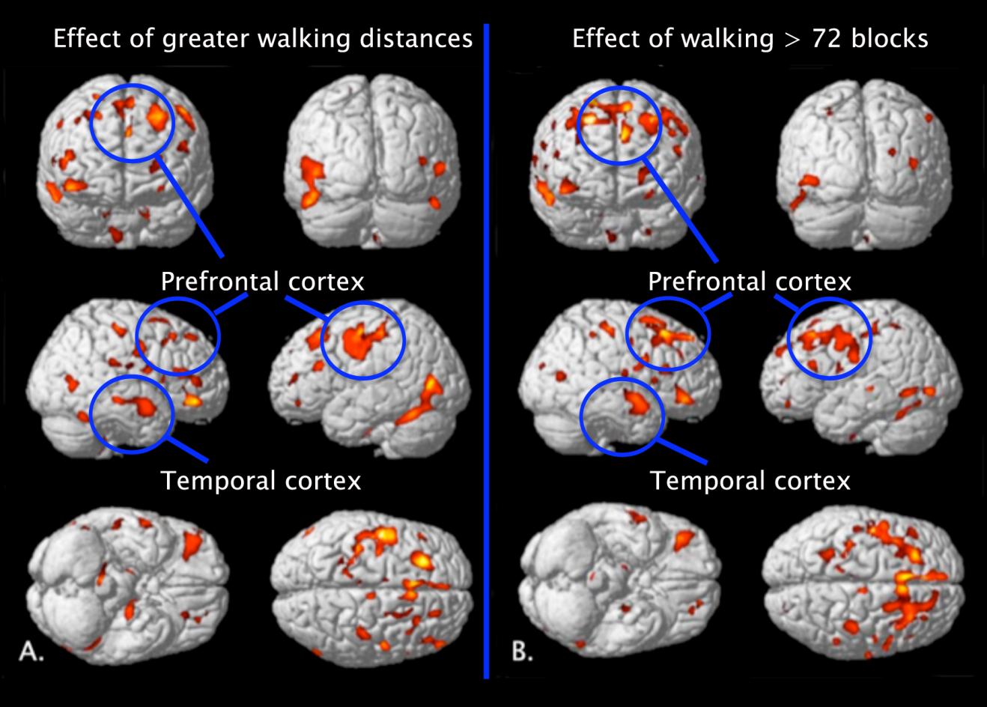
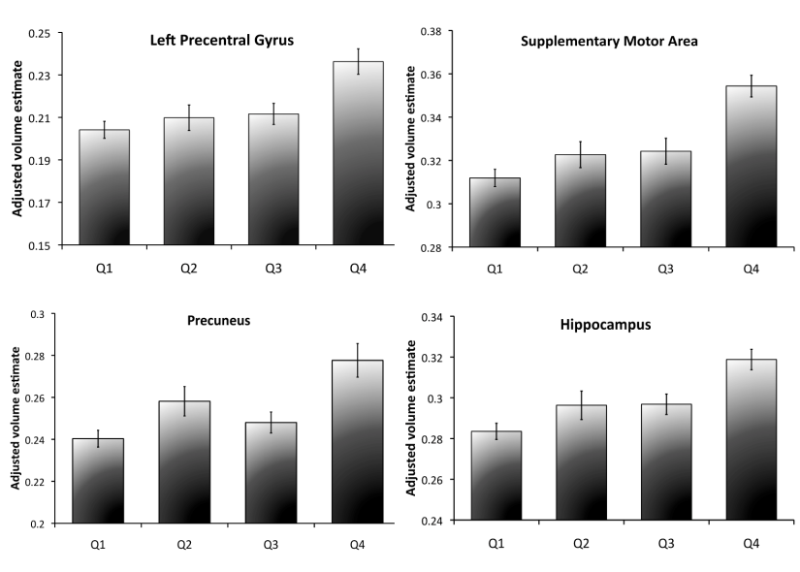
Physical Activity in 1990-91 (blocks walked)
and Gray Matter Volume in 1998-99 in the
Cardiovascular Health Study
Erikson et al. Neurology 2010

Slide 11
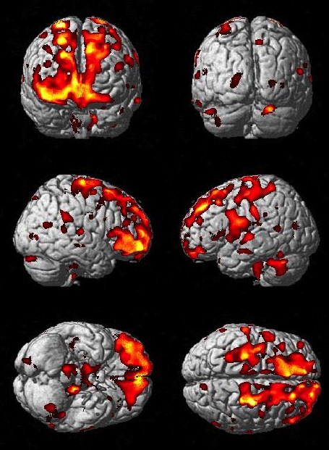
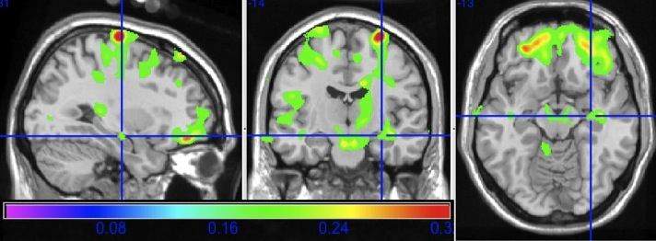
Main Effect of Weekly to Daily Baked or Broiled Fish Consumption on Gray Matter
Main effect of daily to weekly fish consumption on brain structure in cardinal sections projected onto the standard single subject MNI template brain. The cross hairs highlight the left hippocampal GM volume increase in relation to fish consumption
Consumption of baked or broiled (not fried) fish at least one time
per week was positively associated with gray matter volumes
in the hippocampus, precuneus, posterior cingulate, and orbital
frontal cortex even after adjusting for covariates in the analysis
and multiple comparisons (False Discovery Rate p < .05).
There was a high correlation between eicosapentaenoic acid (EPA) and
docosahexaenoic acid (DHA) and fish consumption in our study population
(p < .001).
Raji et al., American J of Preventive Medicine 2014

Slide 12
Alzheimer’s Disease

Slide 13
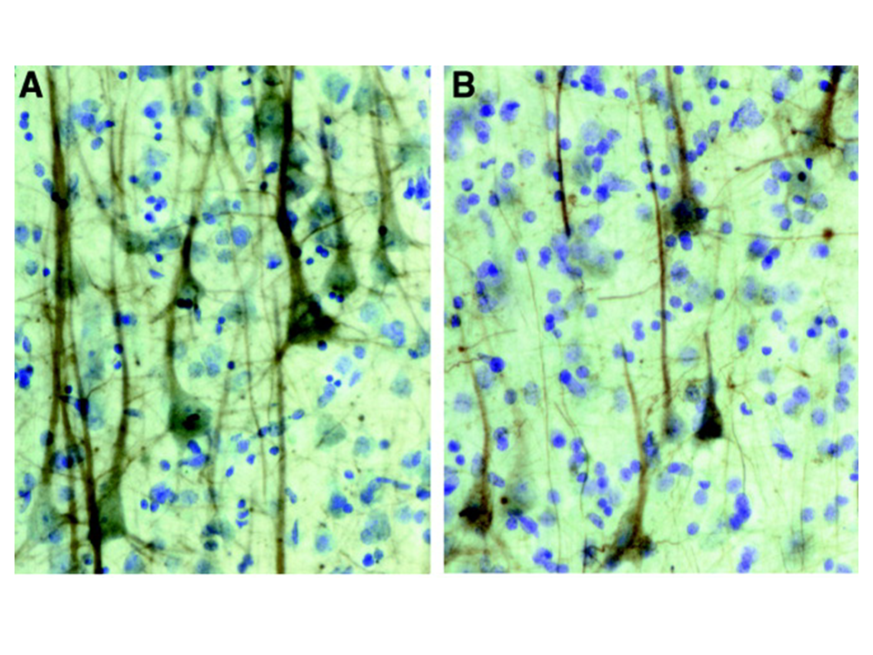
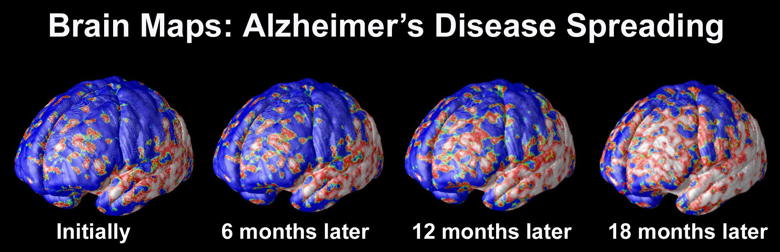
Neurodegeneration
Pyramidal Neuron Loss - CDR 0.5 and 3.0
This is a term used to describe the
progressive loss of structure or function of neurons, including death of neurons.
Early stage
Late stage
Examples of SMI-32 immunohistochemistry in layer IIIc of a CDR 0.5 case (A) and a CDR 3 case (B). Bussière et al. J Comp Neurol. 2003
Thompson, et al. Cerebral Cortex 2000; 11:1-16

Slide 14
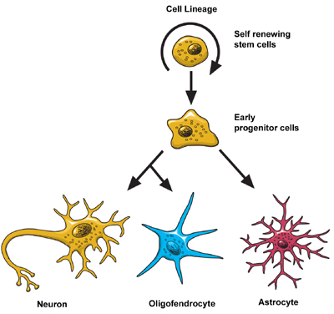
Structural Lesions and Biochemical Changes in AD
Amyloid Plaques
(Aβ deposition)
Neurofibrillary tangles
(tau proteins)
90% loss of the basal
forebrain cholinergic neurons
Synaptic degeneration
Microglia activation
-inflammation-
Cortical TDP-43
(in 30-40% of AD cases)
Cortical Lewy bodies
(in 50-60% of AD cases)
NEURONAL DEATH
  Nerve growth factor
  dysfunction
  Free radicals formation
  Glutamate dysfunction
Other neurotransmitter dysfunction
(e.g., dopamine, noradrenaline, serotonine)

Slide 15
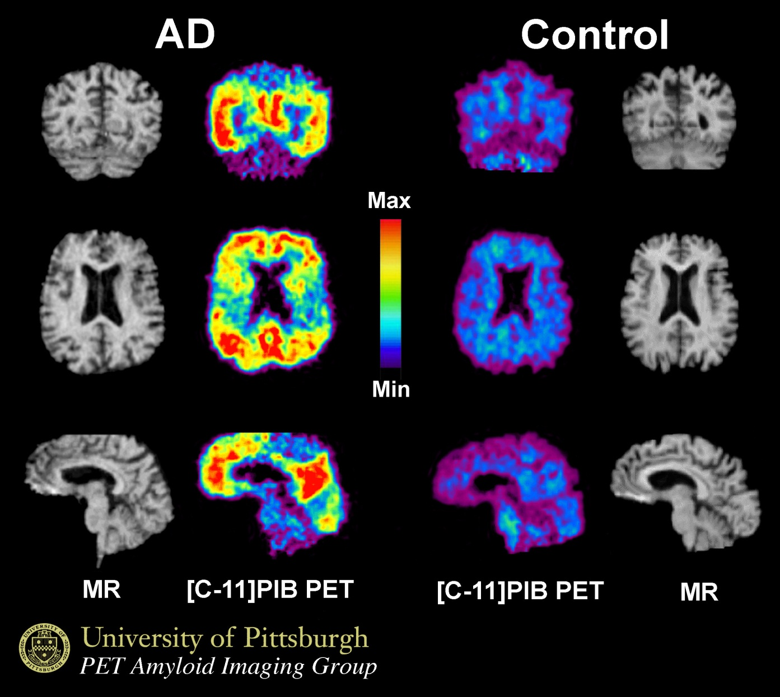

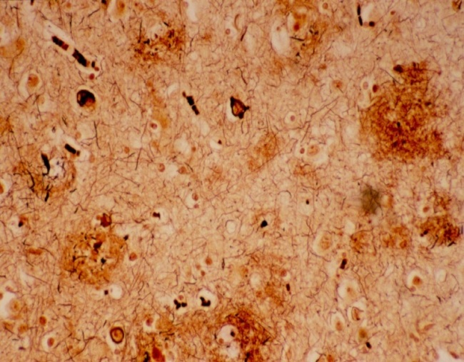
Amyloid deposition in early AD detected with [C-11] Pittsburgh Compound B
Inflammation
Amyloid plaques
Klunk et al. Ann Neurol 2004

Slide 16
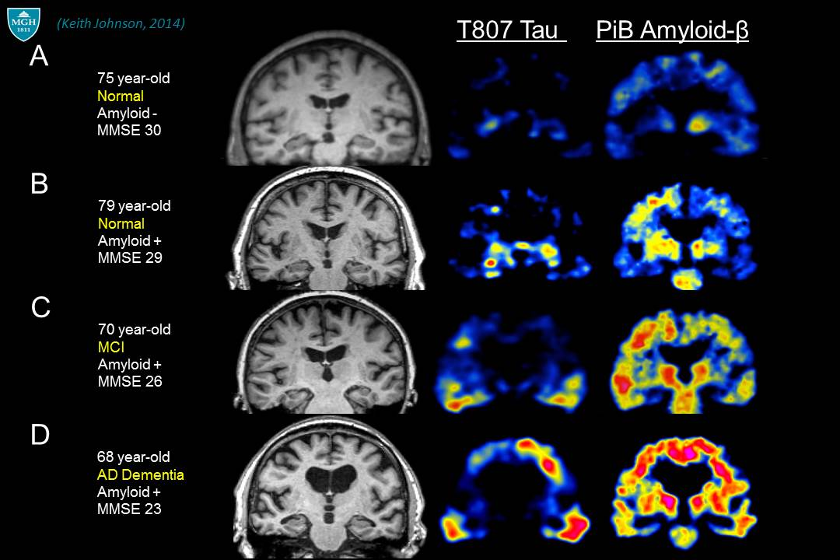
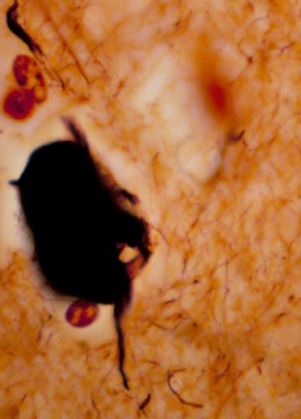
Tau protein deposits detected with ¹⁸F-AV-1451 (also known as ¹⁸F-T807) in normal, MCI, and early AD subjects
Neurofiblillary tangle
(hyperphosphorilated
tau proteins)

Slide 17
Pathological Cascade and Treatment
Pathology
Clinical symptoms
Treatment
Genetic predisposition
Normal
Environmental
factors
Presymptomatic
Alzheimer’s disease
Age
Primary prevention
Mild Cognitive
Impairment
Neurofibrillary tangles, Amyloid plaques, Lewy bodies
Secondary prevention
Inflammation
Dementia
Mitochondrial
dysfunction
Oxidative stress
Symptomatic and
disease modifying
treatments
Apoptosis
Neuronal death

Slide 18
Approved Medication for Alzheimer’s disease
Tacrine (1993)
Donepezil (1997)
Rivastigmine (2000)
Galantamine (2001)
Memantine (2003)
Cholinesterase
Inhibitors
n-methyl-d-aspartate
(NMDA)
receptor modulator

Slide 19
Experimental Therapies
for Alzheimer’s Disease
Symptomatic
Treatments
Disease Modifying
Treatments
Cell
Therapy

Slide 20
Current and Experimental Therapies for
Alzheimer’s Disease
Symptomatic
Passive and active immunizations (IV-Ig, bapineuzumab)
Cell Therapy
Stem Cell
Cholinergic agonists (Nicotinic and Muscarinic M1 agonist)
Gene therapy
Beta and Gamma Secretase inhibitors or modulators (Semagestat)
Aβ RAGE Inhibitors (TTP488)
Amyloid plaque proliferation or aggregation blockers (Scyllo-Inositol, Chelators [Clioquinol])
Anti-NFT, or hyper-phosphorilation of tau protein inhibitors (GSK-3 inhibitors)
Reduction of β-amyloid protein deposits by inhibiting retinoid X receptors (Bexarotene)
Neuroprotection (Resveratrol)*
Neurosteroids (Allopregnanolone)
Histamine H3 receptor (H3R) antagonists
Psychotropics (Lithium, Valproic Acid, SSRIs)
Antihypertensives (ACEI Inhibitors)
Anti-inflammatories (ibuprofen, celecoxib)
Diet (Axona®*, ketogenic diets)
Antioxidants (Souvenaid®)*
Cholinesterase inhibitors*
Memantine (Namenda®)*
Disease Modifying
Nerve Growth Factor
(*Available)

Slide 21
Multiple Administration Routes
Oral/Nasal
Cholinesterase inhibitors
Rosiglitazone
IV/Subcutaneous
IV-Ig
Gantenerumab
Device/Surgery
Encapsulated cell biodelivery of NGF
Ventriculoperitoneal shunt
Bapineuzumab
Scyllo-inositol
Bexarotene
Semagacestat
Memantine
Solaneuzumab
Deep brain stimulation of the fornix
Anti-inflammatories
Autologous fibroblasts genetically modified to express NGF into the forebrain.
Insulin Nasal Spray
Liraglutide
Plasma Exchange
(albumin replacement)
Resveratrol
Aducanumab

Slide 22
Prevention Trials
Trial | Compound (s) | Characteristics
Women Health Initiative Memory Study | Conjugated equine estrogens (CEE) plus medroxyprogesterone acetate (MPA) STOPPED/NEGATIVE Subjects on CEE with or without MPA had increased risk of dementia, but not MCI. | Women age >65 2497 placebo vs CEE 7479 placebo vs CEE + MPA
Alzheimer’s Disease Anti-inflammatory Prevention Trial (ADAPT) | Naproxen and Celecoxib STOPPED | 2600 men and women age >70 with family history of dementia
Ginkgo Evaluation of Memory Study (GEMS) | Ginkgo-biloba NEGATIVE | 3000 women and men age >75
GUIDAGE 14 sites in France | Ginkgo-biloba (EGb-761) NEGATIVE | 2600 men and women with subjective memory complaints age >70
Prevention of Alzheimer’s Disease with Vitamin E and Selenium (PREADVISE) | Vitamin E and Selenium ? | 10,000 men age >60 participating in a prostate cancer prevention trial
PHSII Physician’s Health Study | Beta-carotene, folic acid, vitamin E ? | 10,000 men and women age >65; Assessments by phone and mail

Slide 23
Secondary Prevention Trials
Completed studies
Author | Compound | Number of Subjects | Conversions to dementia | Results
Feldman H, et al. InDDEX Study Lancet-Neurol 2007; 6: 501-512 | Rivastigmine | 1,018 Amnestic MCI patients | 197 (19.3%) | NEGATIVE
Petersen R, et al. NEJM 2005; 352: 2379-2388 | Donepezil + Vitamin E | 769 Amnestic MCI patients | 212 (27.5%) | NEGATIVE
Winblad B, et al Neurology 2008; 70: 2024-2035 | Galantamine | 2,048 Amnestic MCI patients | 232 (11.3%) | NEGATIVE
Current Studies
National Institute on Aging + Lilly –The A4 Study | Solaneuzumab | 1,000 patients with SCC and Amyvid scan positive | ? | ?
Takeda + Zinfanfel | Pioglitazone | 5,800 MCI patients stratified by APOE-4 and TOMM40 | ? | ?
Dominantly Inherited Alzheimer Network Trial (DIAN-TU) NIA- Roche | Gantenerumab | 210 patients with autosomal-dominant Alzheimer's disease mutation ( age 18-80) | ? | ?

Slide 24
Long-term Use of Dementia Medication
in Patients with Alzheimer’s Disease

Slide 25
Treatment with cholinesterase inhibitors Over 3 Years
Double-blind
Open-label
-6
**
*
-4
***
-2
0
Overall
P = .004
2
4
6
LS Mean Change From Week 0 in MMSE
Score (Mixed Regression Model)
Mean Change From Week 0
in ADAS-cog Score
8
P = .057
10
*
12
14
16
6-mo placebo
18
12-mo placebo
Donepezil
20
Estimation of decline
Donepezil delayed start
22
Galantamine 24-32/24 mg
Projected placebo
24
0
3
6
9
12
18
24
30
36
Study Month
0
24
52
78
104
130
156
Study Week
*P < .05; **P < .01;
***P < .001 between groups
Raskind MA, et al. Arch Neurol. 2004.
Winblad B, et al. Dement Geriatr Cogn Disord. 2006.

Slide 26
The effects of dementia medication
on the natural history of Alzheimer’s disease
Time to severe cognitive stage (e.g., MMSE<9)
Time to severe functional stage (e.g., BDRS for ADL >12)
Time to nursing home admission
Time to death

Slide 27
Significant delay to nursing home admission
p=0.004
1.0
0.8
Cumulative survival
0.6
0.4
Taking ChEI
Never used ChEI
0.2
0.0
0
12
24
36
48
60
72
84
96
Time to nursing home admission (0-96 months)
Lopez OL, et al. J Neurol Neurosurg Psychiatry 2002;72:310-314

Slide 28
There is no association between cholinesterase inhibitors use and time to death
1.0
0.8
Cumulative survival
0.6
p=0.07
0.4
Taking ChEI
Never used ChEI
0.2
0.0
0
12
24
36
48
60
72
84
96
Time to death (0-96 months)
Lopez OL, et al. J Neurol Neurosurg Psychiatry 2002;72:310-314

Slide 29
Combination Therapy for Alzheimer’s disease

Slide 30
Memantine + Donepezil Combination in Moderate to Severe AD Study: Severe Impairment Battery
P=.06
P=.03
P<.001
P=.006
P<.001
P<.001
Improvement
Mean Change From
Baseline in SIB Score
Deterioration
Memantine+Donepezil
Placebo+Donepezil
Treatment Week
Time in
weeks
0
4
8
12
18
24
End Point
n =
198
197
190
185
181
171
198
n =
197
194
180
169
164
153
196
Tariot et al. JAMA. 2004;291:317-324.
Notes:
Purpose:
To illustrate graphically the results on the SIB
Key Points:
This figure depicts the mean change from baseline by visit and end point on the SIB (using OC and LOCF).
There was a statistically significant difference in cognitive performance favoring memantine over placebo as measured by the SIB rating scale as early as week 8, and lasting for the duration of the study.
Statistically significant differences between the groups from week 8 onward; P = .057 at week 4.
Memantine: end point +1.1, showing improvement above baseline. Placebo end point –2.3 (P<.001).
Additional Information:
The SIB is a 40-item scale that evaluates cognitive performance—attention, language, praxis, visuospatial ability, construction, memory, and social interaction—in moderate to severe AD. The test is scored from 0 (greatest impairment) to 100.
SIB baseline scores were roughly 78 in both groups.
ADCS reports that for untreated patients with AD whose scores were 5-9, average deterioration rate on the SIB was roughly 3.19 points per month; and for untreated patients with AD whose MMSE were 10-15, the rate of change was 2.08 points per month. The patients in this trial are not declining at that rate; remember the patients are stabilized on donepezil, so they are considered “treated” prior to entering the study.
— A study of treating patients stabilized on donepezil is unprecedented. The fact that significant changes are even
seen speaks to the sensitivity of the SIB in this patient population.
Patients with SIB scores less than 63 are considered to be very severely impaired. This range typically corresponds with a MMSE of < 4.

Slide 31
Memantine + Donepezil Combination in Moderate to Severe AD Study: Neuropsychiatric Inventory
4
p<0.001
2
Improvement
p<0.01
p<0.01
0
Mean change from baseline
-2
Worsening
-4
Combination therapy
Placebo + donepezil
0
12
24
Endpoint (LOCF)
Study week
Cummings et al. Neurology 2006; 67 (1): 57–63

Slide 32
Studies that compared monotherapy to combination therapy (CT)
Author/Study | Year | Type | Duration | Number of Patients | Primary Outcome measures | Results
Tariot et al. | 2004 | Randomized controlled | 24 weeks | 404 | SIB, ADCS-ADL | Positive for CT
Porsteinsson, et al. | 2008 | Randomized controlled | 24 weeks | 433 | ADAS-Cog, CIBIC-Plus. | No effects for CT
Cummings, et al. | 2006 | Randomized controlled | 24 weeks | 403 | NPI | Positive for CT
DOMINO-AD | 2012 | Randomized controlled | 52 weeks | 295 | MMSE, BADLS | Donepezil better than CT
Dysken et al. (TEAM-AD) | 2014 | Double blind, placebo controlled, randomized | 2.2 years | 613 | ADCS-ADL | Vitamin E+ ChEI better than ChEI alone. No effects for CT +/- Vit-E
Atri et al. | 2008 | Observational | 30 months | 382 | IMC subscale of BDS, WADLS | CT better than monotherapy
Schneider et al. | 2011 | Observational | 2 years | 188 | ADAS-Cog, MMSE, CDR, FAQ | MMSE and CDR: Monotherapy better than CT
Lopez et al. | 2009 | Observational | 7.5 years | 943 | Time to nursing home admission (NH) or death | NH: CT better than monotherapy or no therapy
Zhu et al. | 2013 | Observational | 6 years | 201 | Time to severe scores in the MMSE and BDR-ADL, or death | ChEI or CT better than no therapy; Memantine decreased mortality risk
MMSE: Mini-Mental State Examination, SIB: Severe impairment Battery, ADCS-ADL: Alzheimer’s Disease Cooperative Study-Activities for Daily Living, CIBIC: Clinician’s Interview-based impression of change, IMC-BDS: Information-Memory-Concentration-Blessed Dementia Scale, CDR: Clinical Dementia Rating, BADLS: Bristol Activities of Daily Living Scale, WADLS: Weintraub Activities of Daily Living Scale; FAQ: Functional Activities Questionnaire, ADAS-Cog: Alzheimer’s Disease Assessment Scale-Cognitive subscale; BDR-ADL: Blessed Dementia Rating Scale for Activities for Daily Living

Slide 33
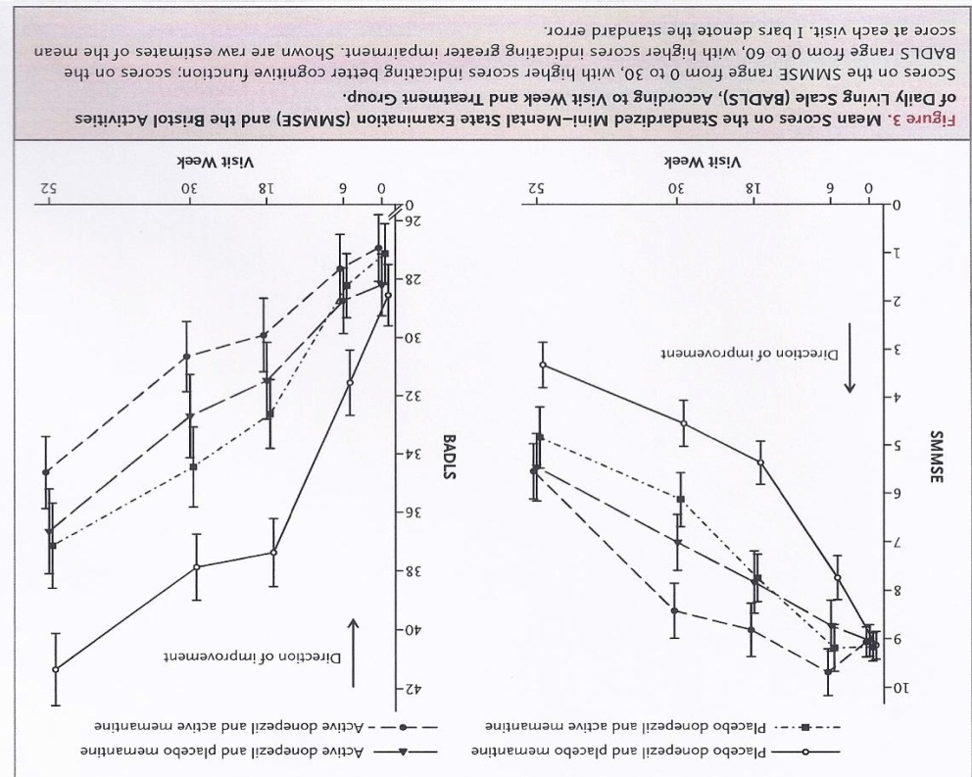
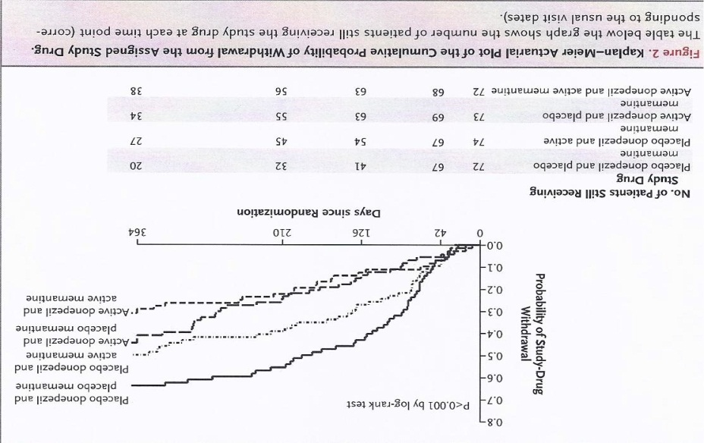
Donepezil and Memantine for Moderate-to-Severe Alzheimer’s disease (DOMINO) Study
-52-weeks double-blind, placebo-controlled trial-
Asked to participate in the study, N= ?
Screened
N= 318
Entered the study
N= 295
Completed the study
N= 119 (40%)
Conclusion with caution:
There were no significant benefits of the combination of donepezil and memantine over donepezil alone
Donepezil was associated with
cognitive and functional benefits
over the course of 12 months
Howard, et al. NEJM 2012; 366: 893-903

Slide 34
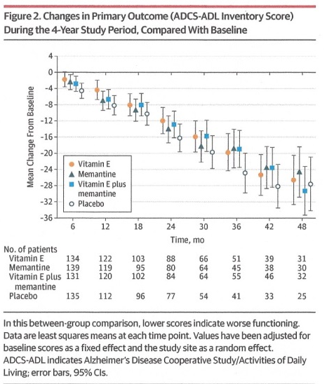
Effects of vitamin E and memantine on functional decline in Alzheimer’s disease
- The TEAM-AD VA Cooperative Randomized Trial
706 Asked to
Participate
613 Randomized
128 (21%) died
357 (58%)
Completed the study
118 (19%)
Provided data at
48-month FU
Dysken et al. JAMA 2014; 311: 33-44

Slide 35
Long-term effects of the concomitant use of memantine with cholinesterase inhibitors (ChEIs) in Alzheimer’s disease: Probable AD patients enrolled from 1983 to 2004
 | No medication | ChEI alone | ChEI + Memantine | p-value
Number of patients | 416 | 387 | 140
Follow-up (months) | 62.3 + 35.8 | 44.6 + 31.0 | 40.4 + 19.7 | <0.001
Age | 71.8 + 8.1 | 74.6 + 8.5 | 72.8 + 10.2 | <0.001
Women (%) | 285 (68.5) | 261 (67) | 89 (64) | n.s.
Education level | 12.1 + 2.9 | 12.4 + 2.9 | 13.3 + 3.1 | <0.001
MMSE | 17.4 + 5.6 | 18.9 + 5.1 | 18.6 + 5.1 | <0.001
APOE-4 (%) (n=714) | 120 (55) | 222 (60) | 74 (58) | n.s.
Hypertension (%) | 106 (26) | 201 (52) | 67 (48) | <0.001
Diabetes (%) | 27 (6.5) | 30 (8) | 6 (4) | n.s.
Heart disease (%) | 35 (8) | 66 (17) | 31 (22) | <0.001
MMSE: Mini-mental State Examination
Lopez et al. J Neurol Neurosurg Psychiatry 2009; 80 (6): 600–607

Slide 36
Memantine in combination with Cholinesterase inhibitors delays nursing home admission (Cohort 1)
(N= 943 Probable AD Patients)
1.00
Memantine plus ChEIs
ChEIs alone
0.75
No dementia medication
Untreated patients used as reference group
Estimated proportion not
admitted to nursing home
0.50
0.25
0.00
0.0
2.5
5.0
7.5
10.0
12.5
15.0
17.5
20.0
Follow-up time (years)
Lopez et al. J Neurol Neurosurg Psychiatry 2009; 80: 600–607
Notes:
36
In the analysis of Cohort 1, untreated patients were used as the reference group.¹ AD patients receiving ChEIs alone had a significant delay to nursing home placement; this effect was significantly augmented with the addition of Ebixa®.¹ Thus, the study revealed that the addition of Ebixa® to ChEI therapy significantly altered the treated history of AD by extending time to nursing home admission compared with ChEI treatment alone or no medication.¹
1. Lopez OL, Becker JT, Wahed AS, et al. Long-term effects of the concomitant use of memantine with cholinesterase inhibition in Alzheimer disease. J Neurol Neurosurg Psychiatry 2009; 80 (6): 600–607.

Slide 37
Memantine in combination with ChEI delays nursing home admission
(Cohort 2)
1.00
0.75
Estimated proportion not
admitted to nursing home
0.50
Memantine plus ChEIs
ChEIs alone
0.25
0.00
0
1
2
3
4
5
6
7
Follow-up time (years)
Patients on ChEIs used as reference group
Lopez et al. J Neurol Neurosurg Psychiatry 2009; 80: 600–607
Notes:
37
In Cohort 2, patients receiving ChEI alone were used as the reference group.¹ In this cohort of 429 patients, the risk of nursing home admissions was reduced by a factor of >7 when Ebixa® was combined with a ChEI, compared with ChEI monotherapy.¹ There was no association of medication use with time to death; nursing home placement was a predictor of time to death, however.¹
1. Lopez OL, Becker JT, Wahed AS, et al. Long-term effects of the concomitant use of memantine with cholinesterase inhibition in Alzheimer disease. J Neurol Neurosurg Psychiatry 2009; 80 (6): 600–607.

Slide 38
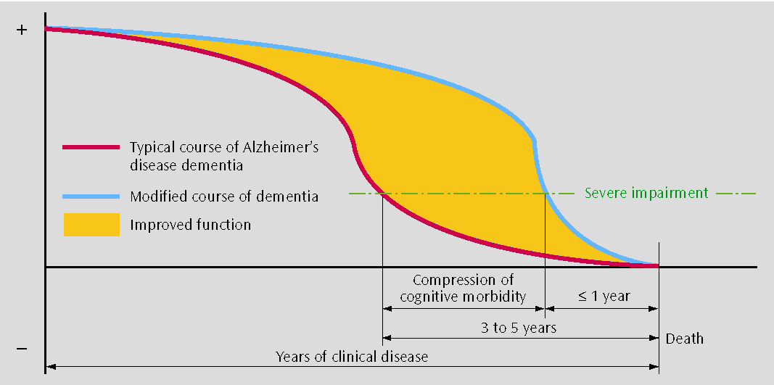
Compression of Morbidity
Becker JT, Tarraga-Mestre L, Ziolko S, Lopez OL. American Journal of Psychiatry 2007: 164: 849-52.

Slide 39
COMMENTS
No treatment for AD has been approved since 2003.
Patients taking ChEIs alone, or in combination with memantine, were less likely to be admitted to a nursing home during follow up vs. untreated patients
Combination therapy offered a 3.4 relative risk reduction in nursing home placement vs. ChEIs alone
There was no association between medication use and time to death.
There is a clinically meaningful alteration of the natural history of AD by dementia medication.
Aging (and associated diseases) can alter brain structure and represents a vulnerability state for Alzheimer’s disease.
Lifestyles can improve brain volume and may provide “protection” for cognitive impairment.

